Slide 1
Kitchen Attention Breaker

Slide 2
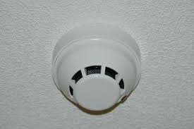


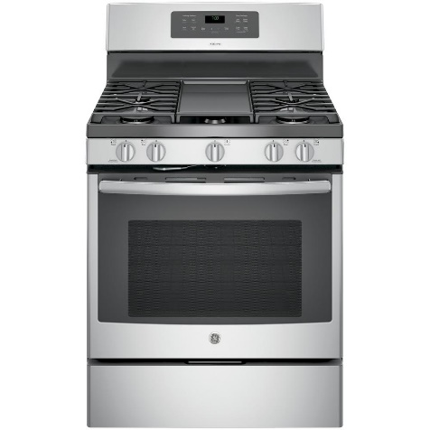
What it is & usability
Prevent burned kitchen when attention is being occupied.
Effective, but too late.
Can’t really turn off
Annoying
BUT STILL NEEDED.

Slide 3
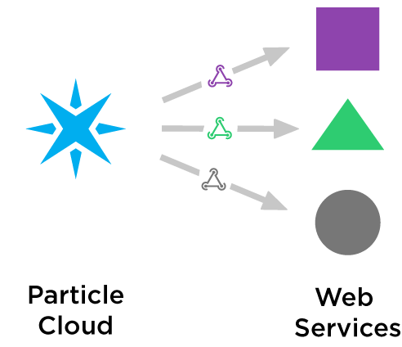
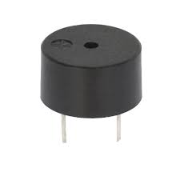
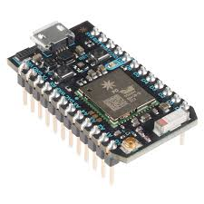
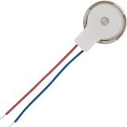
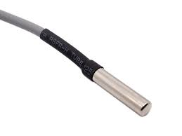
System Concepts
Things Speaks
Buzz!
Webhooks / publish & subscribe
Vibrate!
Get temperature data
Compute when temperature spikes occurs
Trigger all subscribers
Update temperature

Slide 4
System cont.
Particle publish/subscribe:
How to handle complicated devices id and their responsibilities
Who get to be the publisher and the subscribers and who get to be both.
Identified by event names!
Temperature Spike: Compute average of last X data points, compare with the new read and a threshold value.
Humidifier Spike: Compute average of last X data points, compare with the new read and a threshold value.
When to sound the buzzer: From the spikes values, when to decide to publish the alarm event?

Slide 5
Scalability & Advantages
Highly scalable!
Attach a buzzer to the TV
Attach a vibrator to your wristband
Attach a blink led to living room
Devices can communicate independently from one another.
Replaceable if a unit is down

Slide 6
Disadvantages
High cost
Redundant processors
Code complexity -> inefficient maintenance
Difficult to troubleshoot communications
Setting up is complicated
Using is complicated

Slide 7
Demo

